Slide 1
Logic Design
Chapter 5
Synchronous Sequential Logic
(Storage Elements)

Slide 2
Reading Assignment:
Digital Design" 6th edition, by Morris Mano and D. Ciletti
5.2 Sequential Circuits
5.3 Storage Elements: Latches
5.4 Storage Elements: Flip‐Flops

Slide 3
Review: Combinational Circuits
contains no memory elements
the outputs depends on the inputs only
I
Combinational Circuit
Y = F(I)
3

Slide 4
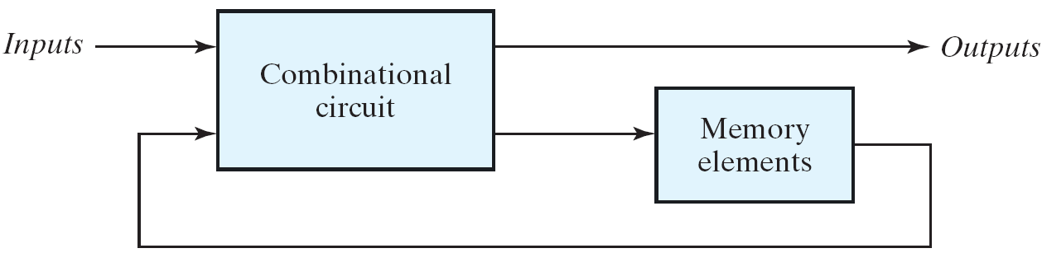
Sequential Circuits
consists of a combinational circuit to which memory elements are connected to form a feedback path.
the binary information stored in memory elements defines the state of the sequential circuit at that time.
(inputs, present state) ⇒ (outputs, next state)
two main types of sequential circuits
synchronous: the transition happens at discrete instants of time
asynchronous: at any instant of time
next state
present state
4

Slide 5
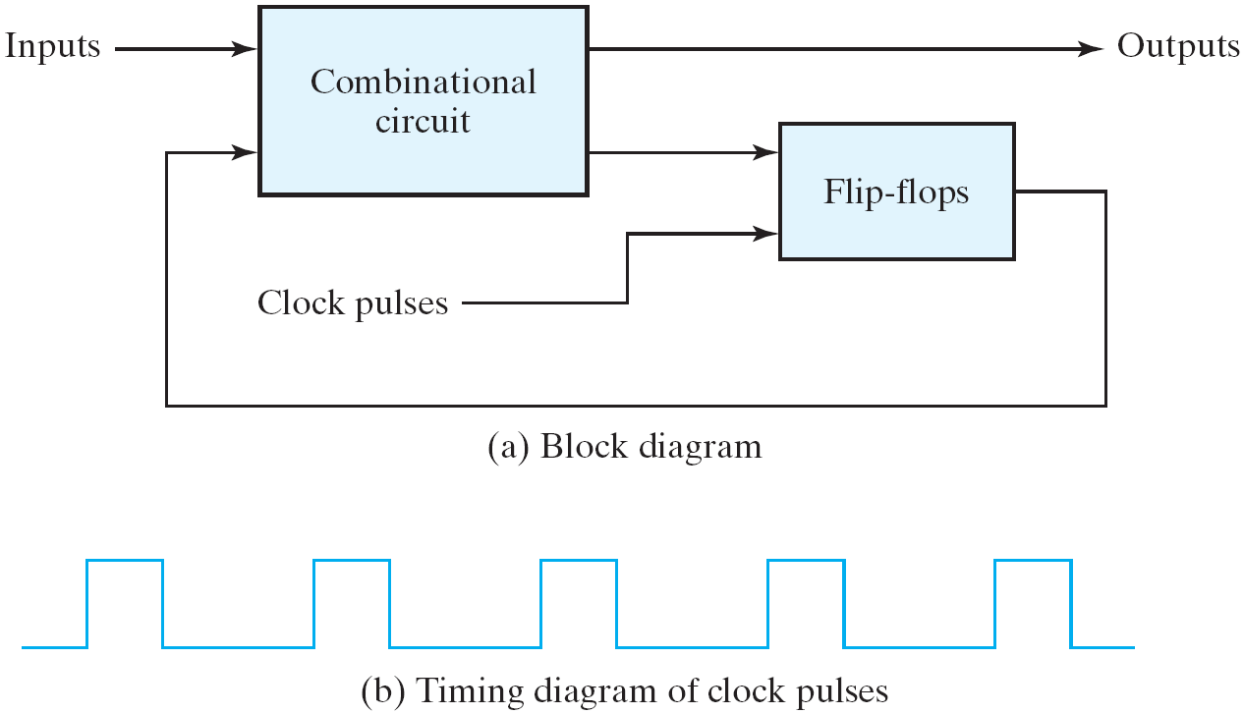
Synchronous Sequential Circuits
a master-clock generator to generate a periodic train of clock pulses
the clock pulses are distributed throughout the system
most commonly used
the memory elements: flip-flops
binary cells capable of storing one bit of information
two outputs: one for the normal value and one for the complement value
5

Slide 6
Storage Element: Latch

Slide 7
SR Latch :with NORs
NOR gate:
‘0’ if either of its inputs are ‘1’
S = set
R = reset
Q = output
S R Q Q’
1 0
0 1
0 0
1 1
1
0
0
1
hold
hold
forbidden
0
0
Function table
7

Slide 8
SR Latch :with NORs
0
1
1
0
0
1
1
0
0
1
0
0
0
1
8

Slide 9
SR Latch :with NORs
Re-examine the inputs S=1 and R=1:
What does it mean to both set and reset at the same time? S-R latch says “both lose!” → Q and Qb both are 0
What happens when S=R=1 (Q=Qb=0) and S or R changes to 0?
S changes to zero first → Reset wins (Q=0, Qb=1)
R changes to zero first → Set wins (Q=1, Qb=0)
Both change at the same time to S=R=0…
When S=R=1 changes to S=R=0, we get an uncontrolled oscillation (unstable)
R
1
0
Q
S
R
Q
0
Qb
S
1
Qb
Moral of the story: S=R=1 is bad → Make it an illegal input
9

Slide 10
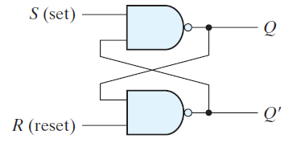
SR Latch :with NANDs
NAND gate:
‘1’ if either of its inputs are ‘0’
S = set
R = reset
Q = output
S R Q Qb
0 1
1 0
0 0
1 1
1
0
0
1
forbidden
1
1
hold
hold
Function table
10

Slide 11
SR Latch :with NANDs
0
1
1
0
0
1
1
0
0
1
1
1
0
1
11

Slide 12
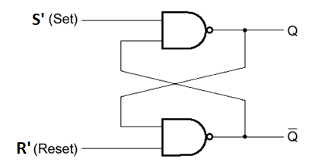
SR Latch :with NANDs
Sometimes it is called S’R’ Latch.
The primes designate the fact that the inputs must be in their complement form to activate the circuit.
S’ R’ Q Qb
0 1
1 0
0 0
1 1
1
0
0
1
1
1
hold
hold
12

Slide 13
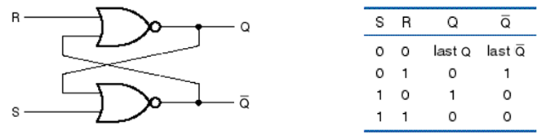
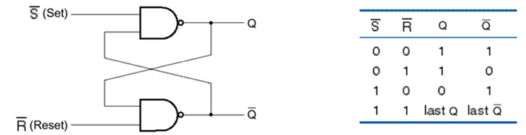
SR Latch and S’R’ Latch
An S-R latch –with active high set and reset inputs – can be built using NOR gates
An S′R′ latch –with active low set and reset inputs – can be built using NAND gates
13

Slide 14
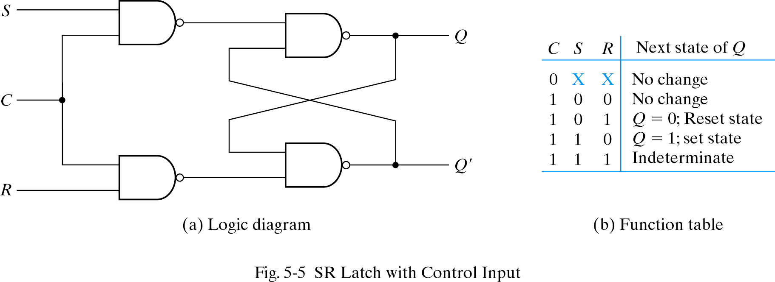
S-R Latch with control input
14

Slide 15
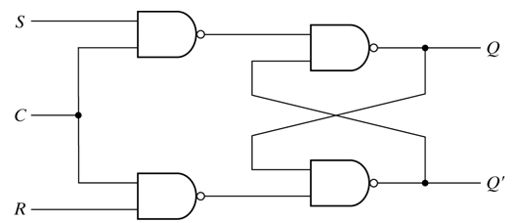
S-R Latch with control input
C = 0 disables all latch state changes
1
0
1
C = 1 enables data change
S’R’ Latch
S’
1
R’
15

Slide 16
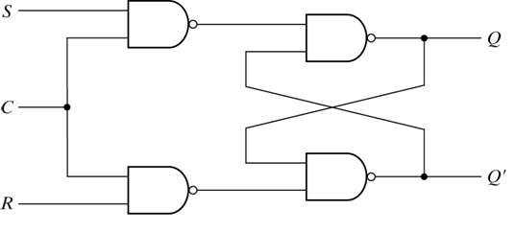
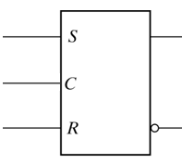
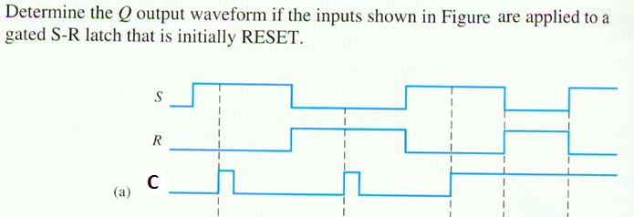
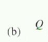
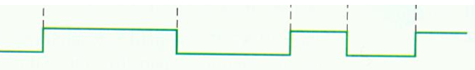
S-R Latch with control input
16

Slide 17
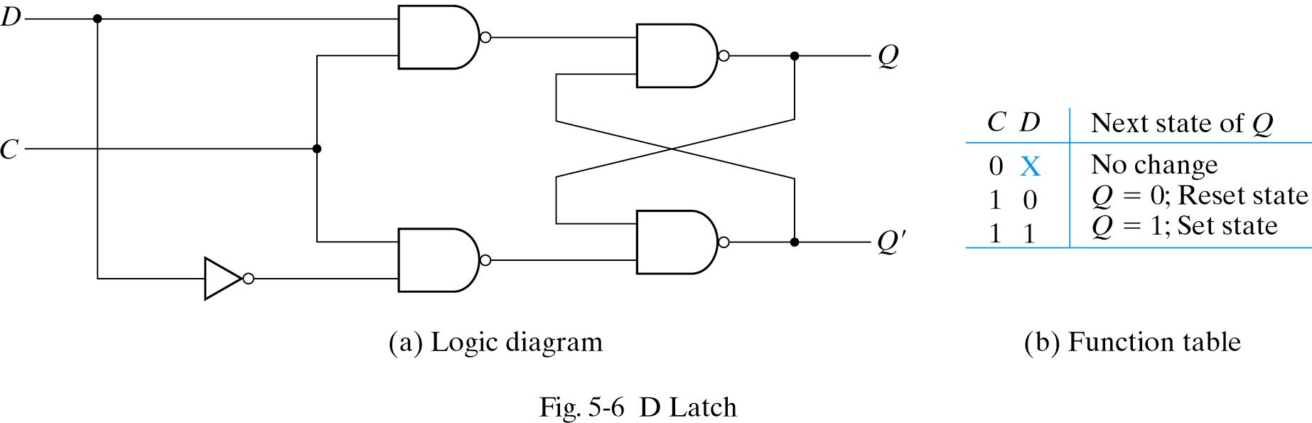
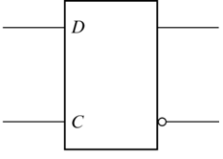
D Latch
Input value D is passed to output Q when C is high
Input value D is ignored when C is low
17

Slide 18
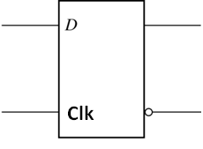
D-Latch
D
S
(Data)
Q
Clk
Q
R
(a) Circuit
t
1
t
2
t
3
t
4
Clk
D
Q
Time
(d) Timing diagram
18

Slide 19
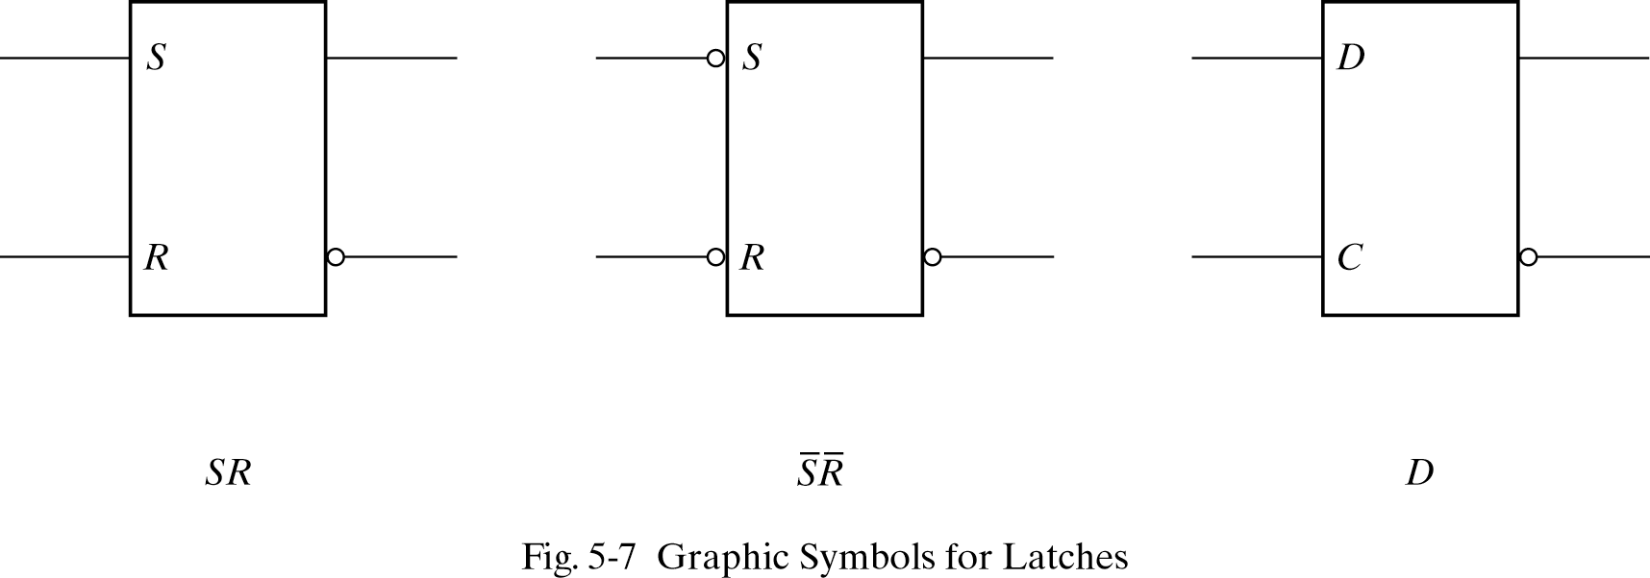
Symbols for Latches
SR latch is based on NOR gates
S’R’ latch based on NAND gates.
D latch sometimes called transparent latch
19

Slide 20
Storage Element: Flip-Flop

Slide 21
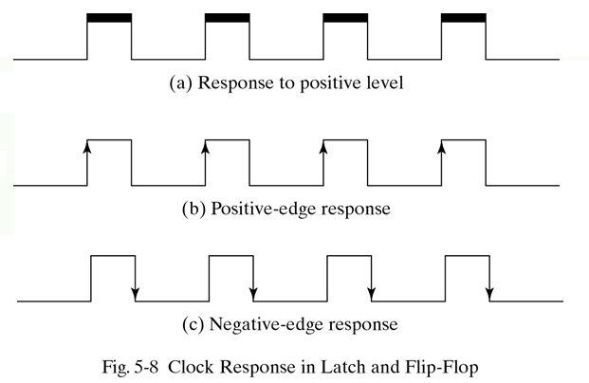
Latch v.s. Flip-Flop
The state of a latch or flip-flop is switched by a change of the control input
Level triggered – latches
Edge triggered – flip-flops
21

Slide 22
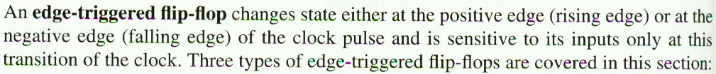
Edge-Triggered Flip-Flops
Edge-Triggered D Flip-Flop
Edge-Triggered J-K Flip-Flop
Edge-Triggered T Flip-Flop
22

Slide 23
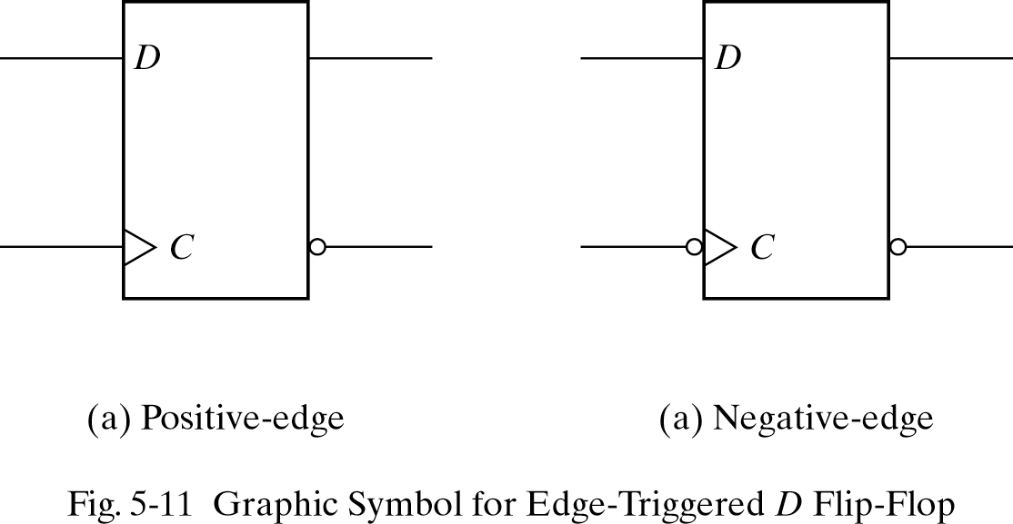
Edge-Triggered D Flip-Flop
D flops can be triggered on positive or negative edge
Bubble before Clock (C) input indicates negative edge trigger
Lo-Hi edge
Hi-Lo edge
23

Slide 24
An Example
D
D
Q
Q
a
Clock
Clk
Q
Q
a
D
Q
Q
b
Clock
Q
Q
D
b
Q
a
D
Q
Q
c
Q
b
Q
Q
c
Q
c
(a) Circuit
(b) Timing diagram
24

Slide 25
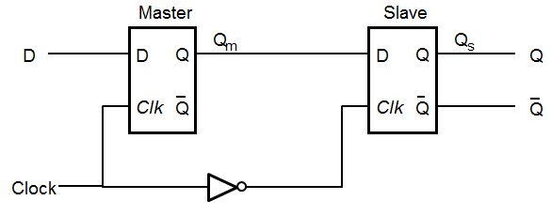
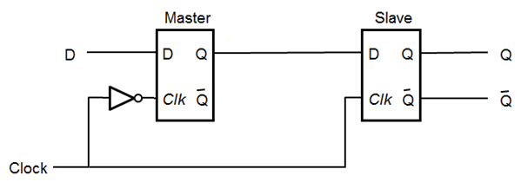
Master-Slave D Flip-Flops
Negative edge-triggered D Flip-Flop
Positive edge-triggered D Flip-Flop
25

Slide 26
Master-Slave D Flip Flop
Master
Slave
Q
m
Q
s
D
D
Q
D
Q
Q
Clock
Clk
Q
Clk
Q
Q
(a) Circuit
Clock
D
D
Q
Q
m
Q
Q
=
Q
s
(b) Timing diagram
(c) Graphical symbol
26

Slide 27
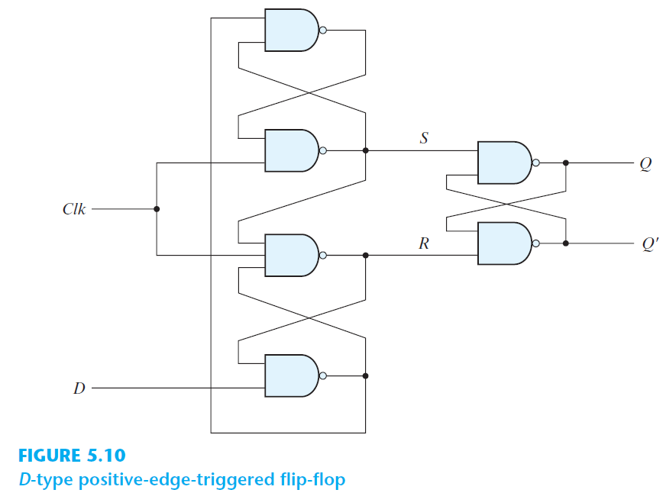
Appendix: Positive Edge-Triggered D Flip Flop
D
Q
Clock
Q
'
'
27

Slide 28
Appendix: Positive Edge-Triggered D Flip Flop
The operation of the circuit is as follows.
When Clock = 0
The S and R inputs of the output latch are maintained at the
logic-1. This causes the output to remain in its present state.
When Clock changes to 1
If D = 0, R’ changes to 0. This causes the flip-flop to go to the
reset state, making Q = 0.
If D = 1, S’ changes to 0. This causes the flip-flop to go to the
set state, making Q = 1.
After Clock changes to 1, any further changes in D will not affect the output latch as long as Clock = 1
If there is a change in the D input from 0 to 1, R’ remains at 0,
making Q stay at 0.
If there is a change in the D input from 1 to 0, S’ remains at 0,
making Q stay at 1.
28

Slide 29
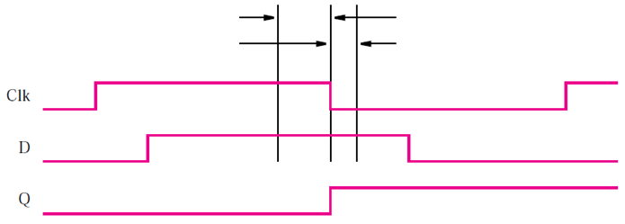
Timing
The setup time
The minimum time that D input must be maintained at a constant value prior to the occurrence of the clock transition.
The hold time
The minimum time that D input must not change after the occurrence of the clock transition
t_{setup}
t_{hold}
Setup and hold times for negative edge-triggered D Flip-flop
29

Slide 30
Asynchronous Inputs
Asynchronous inputs that are used to force the flip flop to a particular state independently of the clock.
Preset (direct set):
The input that sets the flip-flop to 1.
Clear (direct reset)
The input that sets the flip-flop to 0.
When power is turned on, the state of flip-flop is unknown. The direct inputs are used to bring all flip-flops to a known starting state.
30

Slide 31
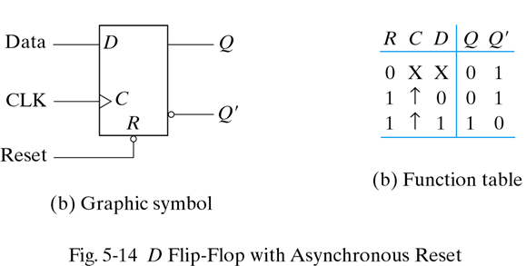
Asynchronous Reset
Note reset signal (R) for D flip flop
If R = 0, the output Q is cleared
This event can occur at any time, regardless of the value of the CLK
31

Slide 32
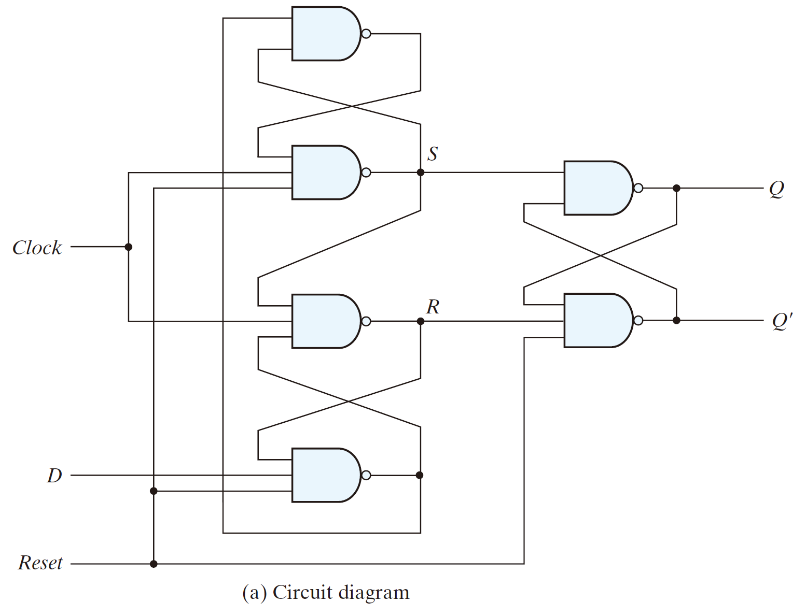
Appendix: Asynchronous Reset
1
0
1
0
32

Slide 33
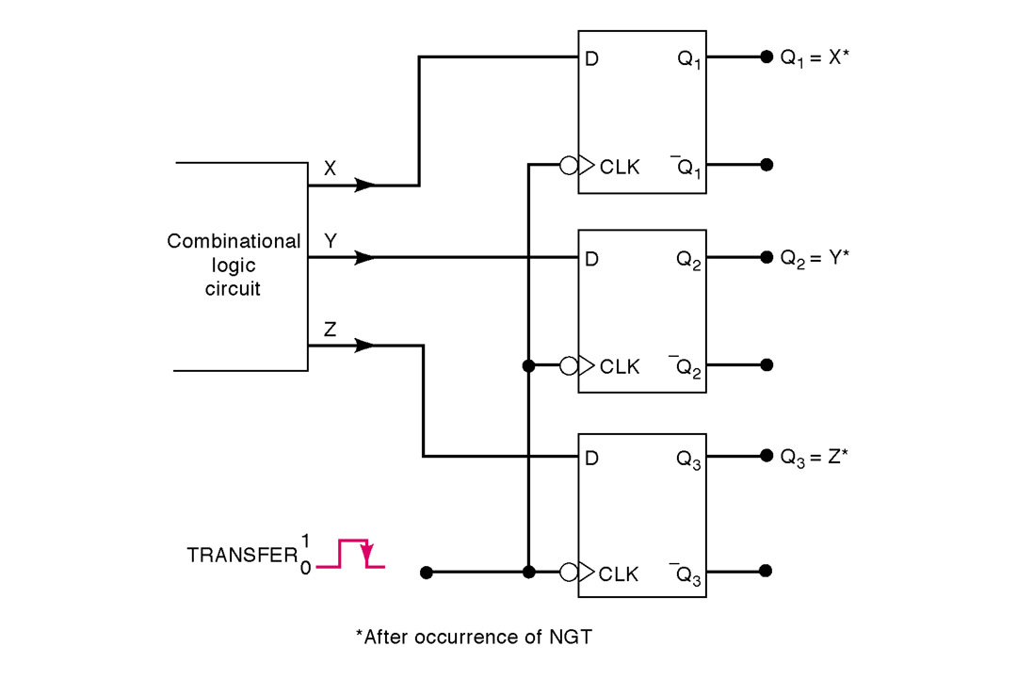
Parallel Data Transfer
Flip flops store outputs from combinational logic
Multiple flops can store a collection of data
33

Slide 34
Positive Edge-Triggered J-K Flip-Flop
J
D
Q
Q
K
Q
Q
Clock
(a) Circuit
J
K
Q
(
t
+
1
)
0
0
Q
(
t
)
J
Q
0
1
0
1
0
1
K
Q
1
1
Q
(
t
)
(b) characteristic table
(c) Graphical symbol
34

Slide 35
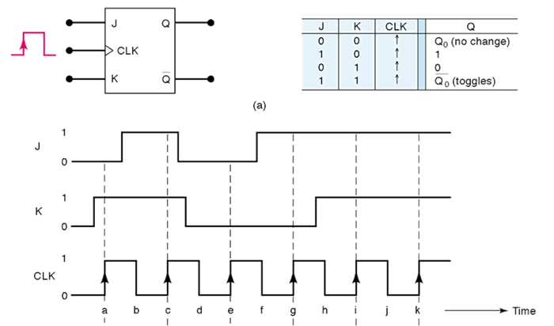
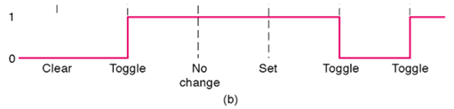
Positive Edge-Triggered J-K Flip-Flop
35

Slide 36
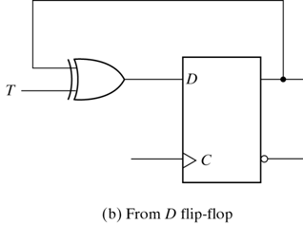
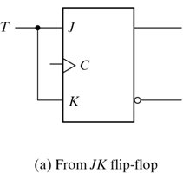
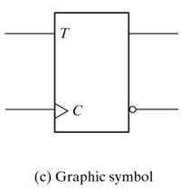
Positive Edge-Triggered T Flip-Flop
T
Q
(
t
+
1
)
0
Q
(
t
)
1
Q
(
t
)
Characteristic table
Clock
T
Q
Timing diagram
36

Slide 37
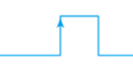
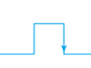
Q(t) vs Q(t+1)
Positive Edge Triggered
Negative Edge Triggered
Clk
Output
Q(t)
Q(t+1)
Clk
Output
Q(t)
Q(t+1)
37

Slide 38
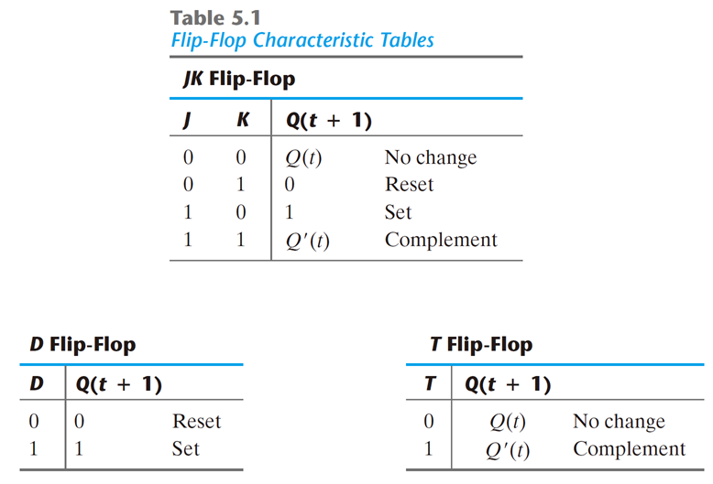
Characteristic Tables
Q(t+1) = JQ'+K'Q
Q(t+1) = D
Q(t+1) = TQ'+T'Q
38

Slide 39
Characteristic Equations
For D Flip flops
Q(t+1) = D
For JK Flip flops
Q(t+1) = JQ’ + K’Q
For T Flip flops
Q(t+1) = TQ'+T'Q = T ⊕ Q
39

Slide 40
Summary
Flip flops are powerful storage elements
They can be constructed from gates and latches!
D flip flop is simplest and most widely used
Asynchronous inputs allow for clearing and presetting the flip flop output
Multiple flops allow for data storage
The basis of computer memory!
Combine storage and logic to make a computation circuit
40
Notes:
credential:
bring a computer
die photo
wafer
:
This can be an hidden slide. I just want to use this to do my own planning.
I have rearranged Culler’s lecture slides slightly and add more slides. This covers everything he covers in his first lecture (and more) but may
We will save the fun part, “ Levels of Organization,” at the end (so student can stay awake): I will show the internal stricture of the SS10/20.
Notes to Patterson: You may want to edit the slides in your section or add extra slides to taylor your needs.

